Slide 1
Unit 4: Concept of cyber space
Why do we need cyber laws: The Indian context
Cyber law – framework – legal recognition –risks arising out of use of computer and computer network.
Aspects of cyber law- intellectual property, data protection and privacy, freedom of expression and crimes committed using computers.
Indian parliament passed its first cyber law, ITA 2000, to provide legal infrastructure for E- commerce in India.

Slide 2
Government felt need to enact relevant cyber laws to regulate Internet based computer related transactions in India.
It manages all aspects, issues, legal consequences and conflicts in the world of cyberspace, Internet or WWW.
In the preamble to the Indian ITA 2000, it is mentioned that it is an act to provide legal recognition for transactions carried out by means of electronic data interchange and other means of electronic communication, commonly referred as an Electronic commerce.

Slide 3
Reasons for enactment of cyber law in India
lacks in many aspects when it comes to newly developed internet technology. It is essential to address this gap through suitable law.
Need to have some legal recognition to the internet as it is dominant source of carrying out business in today’s world.
Internet-cyber terrorism-including disruptive activities.
Keeping all these factors into consideration, Indian parliament passed IT Bill on 17th May 2000—ITA 2000.

Slide 4
E- Commerce
Buying and selling of goods, products or services over the internet. Online transaction of money, funds transfer and data are also part of the E-commerce.
Benefits of E-commerce:
1. sellers can expand their markets to wider area.
2. better and faster transactions
3. sell and buy anytime.
4. customers gets more options and details about product, gets options to compare and select better options.

Slide 5
5. reduces paperwork
6. encourages digital payment
7. reduces physical efforts of people by using online payment options for paying utility bills, buying tickets online, net banking, etc.
8. helps government to promote e-governance by giving facilities such as online payment of taxes, government fees, etc.
One needs to ensure that the transactions made online are secure and with genuine parties.

Slide 6
Types of E-commerce:
Entities- business, consumers and government
Business-to-Consumer (B2C): buying product from Amazon.com
Business-to-Business(B2B): manufacturer procuring raw material from seller online.
Consumer-to-Consumer(C2C): olx.com
Consumer-to-business (C2B): consumer provides a service or a good to business and get paid for it. Eg: freelancing jobs.

Slide 7
few more recently emerged types:
1. BUSINESS-TO-ADMINISTRATION (B2A)
This e-commerce category refers to all transactions between companies and public administration. This is an area that involves many services, particularly in areas such as social security, employment and legal documents.
For example : Accela, a software company that provides government software solutions and public access to government services for permitting, planning, licensing, public health, and so on.

Slide 8
2.CONSUMER-TO-ADMINISTRATION (C2A)
Another popular e-commerce category, C2A e-commerce encompasses all electronic transactions between individuals and public administration. Examples of this include taxes (filing tax returns) and health (scheduling an appointment using an online service).
Examples include taxes (filing tax returns), health (scheduling an appointment using an online service), and paying tuition for higher education

Slide 9
Contract Aspects in Cyber law
Contract is basically a legally-binding agreement between two or more parties creating a legal obligation for both of them to perform specific promised duties such as making a payment, providing services, sale of goods or property.
contract discharged
breach of contract

Slide 10
ELECTRONIC CONTRACT:
-contracts that are not paper based but rather in electronic practice.
-born out of the need for speed, suitability and efficiency
-Imagine a contract that an Indian exporter and an American importer wish to enter into. One option would be that one party first pulls up two copies of the contract, signs them and couriers them to the other, who in turn signs both copies and couriers one copy back. The other option is that the two parties meet someplace and sign the contract.

Slide 11
-In the electronic age, the whole contract can be completed in seconds, with both parties simply attaching their digital signatures to an electronic copy of the contract. There is no need for delayed couriers and additional travelling costs in such a situation. There was initially a hesitation amongst the legislatures to recognize this modern technology, but now many countries have passed laws to recognize electronic contracts.

Slide 12
Types of Electronic Contracts:
Employment Contracts
The Information Technology is determined by manpower in Indian context and thus employment contracts are vital. With a high erosion rate as well as the confidentiality involved in the work employment contracts become crucial. Apart from that Indian Labor practices are based on tough labor laws and not the hire and fire processes of the first world. In this background copyright issues of software development assumes vital importance.

Slide 13
Apart from that contracts for on-site development and sending the workforce abroad and security clauses will play a crucial role in employment contracts. Firms hiring personnel abroad apart from their personnel need to include the relevant employment contract of the place of action.
Consultant Agreements
Here proper care to be taken in Consultant agreements where issues of Intellectual Property Rights, privacy will play an important role. If care is not taken it may lead to cost of business and loss of clients.

Slide 14
Contractor Agreements
Here again privacy, consumer liability and copyright issues assume great importance and care to be taken in representation such contracts.
Sales, Reseller and Distributor Agreements
Distribution, reseller agreement should take care of the aspect of Monopoly Restrictive Trade Practices (in future the competition law) provincial authority and other tax instruments.
Non-Disclosure Agreements
Non-Disclosure Agreements are part of IT contracts, which identify binding agreements with employees apart from the standard confidentiality agreements.

Slide 15
Software Development and Licensing Agreements
A license is an authorization given to do a specific manufacture/sales/marketing/distribution, which is legitimate.
License plays a prevailing form of contract in mass marketing activity of any kind including Information Technology.
Licenses are issued for a single machine practise at a specified location with a provision for backup in the same machine in case of a crash or unreliable functioning.
Multiple machine licenses are also given. The license agreement also protects the user from any copyright or other intellectual property violation of the manufacturer.
The licensing agreements become vital in Cyber Contracts.

Slide 16
Similarly software development is another agreement between joint ventures of companies or for awarding development of software to multiple parties, which assume vital importance in contracts of cyber world.
Shrink Wrap Contracts
A Shrink Wrap contract is the former license agreement required upon the buyer when he buys software. Before he or she tears the pack to use it, he or she is made mindful by tearing the cover or the wrap that they are sure by the license agreement of the manufacture. This is done as previous deliberated to protect the interests of the manufacturer where the consumer cannot replicate the package, copy it or sell it or donate it to others moving the sale of the software.

Slide 17
The license, which is contracted and enfolded in the product, which becomes enforceable and taken as consent before the buyer tears the package. The usual sections that are part of the shrink-wrap license are that of
a) prohibiting illegal creation of copies
b) prohibiting payments of the software
c) prohibition of contrary engineering, decompilation or adjustment
d) prohibition of usage in more than one computer definite for that purpose
e) disclaimer of contracts in respect of the product sold
f) limitations of responsibility

Slide 18
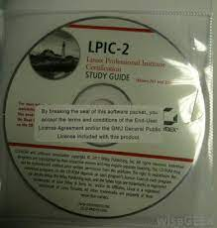
Shrink wrap contract

Slide 19
Click wrap contracts
A click wrap Contract is mostly found as a part of a software. These agreements are rigid in nature and there is no chance of negotiation in it. Because the user of such software has only two options, that is to agree and use that particular software or to disagree with terms and conditions and not to use that particular software.

Slide 20
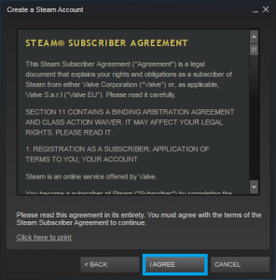
click wrap contract

Slide 21
Browse Wrap Contracts:
A browse wrap agreements are generally found in a website or a downloadable product, these contracts are published on a particular webpage and user have to find these terms and conditions by browsing to that particular web page. Because generally these contracts are hidden.

Slide 22
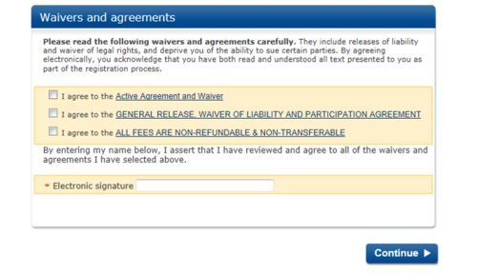
Browse wrap contract

Slide 23
Indian Contract Act, 1872
The Act as enacted originally had 266 Sections, it had wide scope and included.
General Principles of Law of Contract – Sections 01 to 75
Contract relating to Sale of Goods – Sections 76 to 123
Special Contracts- Indemnity, Guarantee, Bailment & Pledge and Agency – Sections 124 to 238
Contracts relating to Partnership – Sections 239 to 266

Slide 24
At present the Indian Contract Act may be divided into two parts:
Part 1: deals with the General Principles of Law of Contract Sections 1 to 75
Part 2: deals with Special kinds of Contracts such as
1.Contract of Indemnity and Guarantee
2.Contract of Bailment and Pledge
3.Contract of Agency.

Slide 25
Key Terms defined in the Indian Contract Act
1. Offer 2(a): When one person signifies to another his willingness to do or to abstain from doing anything, with a view to obtaining the assent of that other to such act or abstinence, he is said to make a proposal.
2. Acceptance 2(b): When the person to whom the proposal is made, signifies his assent there to, the proposal is said to be accepted.
3. Promise 2(b): A Proposal when accepted becomes a promise. In simple words, when an offer is accepted it becomes promise.
4. Promisor and promisee 2(c): When the proposal is accepted, the person making the proposal is called as promisor and the person accepting the proposal is called as promisee.

Slide 26
5. Consideration 2(d): When at the desire of the promisor, the promisee or any other person has done or abstained from doing or does or abstains from doing or promises to do or to abstain from doing something such act or abstinence or promise is called a consideration for the promise.
6. Agreement 2(e): Every promise and set of promises forming the consideration for each other.
7. Contract 2(h): An agreement enforceable by Law is a contract. Therefore, there must be an agreement and it should be enforceable by law.
8. Reciprocal Promises 2(f): Promises which form the consideration or part of the consideration for each other are called 'reciprocal promises'.

Slide 27
9. Void agreement 2(g): An agreement not enforceable by law is void.
10. Voidable contract 2(i): An agreement is a voidable contract if it is enforceable by Law at the option of one or more of the parties there to (i.e. the aggrieved party), and it is not enforceable by Law at the option of the other or others.
11. Void contract 2(j): A contract which ceases to be enforceable by Law becomes void when it ceases to be enforceable.

Slide 28
Electronic Contracts & the ITA, 2008.
ITAA, 2008 has introduced a new section 10A,
“validity of contracts formed through electronic means”,
It states that,
Where in a contract formation, the communication of proposals, the acceptance of proposals, the revocation of proposals and acceptances, as the case may be, are expressed in electronic form or by means of an electronic record, such contract shall not be deemed to be unenforceable solely on the ground that such electronic form or means was used for that purpose.

Slide 29
Attribution, acknowledgment and dispatch of electronic records
Attribution of Electronic Records An electronic record shall be attributed to the originator
if it was sent by the originator himself;
by a person who had the authority to act on behalf of the originator in respect of that electronic record; or
by an information system programmed by or on behalf of the originator to operate automatically.

Slide 30
Acknowledgement of Receipt (Modified by ITAA 2008)
Where the originator has not agreed with stipulated that the acknowledgment of receipt of electronic record be given in a particular form or by a particular method, an acknowledgment may be given by –
any communication by the addressee, automated or otherwise; or
any conduct of the addressee, sufficient to indicate to the originator that the electronic record has been received.

Slide 31
(2) Where the originator has stipulated that the electronic record shall be binding only on receipt of an acknowledgment of such electronic record by him, then unless acknowledgment has been so received, the electronic record shall be deemed to have been never sent by the originator.

Slide 32
(3) Where the originator has not stipulated that the electronic record shall be binding only on receipt of such acknowledgment, and the acknowledgment has not been received by the originator within the time specified or agreed or, if no time has been specified or agreed to within a reasonable time, then the originator may give notice to the addressee stating that no acknowledgment has been received by him and specifying a reasonable time by which the acknowledgment must be received by him and if no acknowledgment is received within the aforesaid time limit he may after giving notice to the addressee, treat the electronic record as though it has never been sent.

Slide 33
Time and place of dispatch and receipt of electronic record
Save as otherwise agreed to between the originator and the addressee, the dispatch of an electronic record occurs when it enters a computer resource outside the control of the originator.
Save as otherwise agreed between the originator and the addressee, the time of receipt of an electronic record shall be determined as follows, namely –
(a) if the addressee has designated a computer resource for the purpose of receiving electronic records

Slide 34
receipt occurs at the time when the electronic record enters the designated computer resource; or
if the electronic record is sent to a computer resource of the addressee that is not the designated computer resource, receipt occurs at the time when the electronic record is retrieved by the addressee;
(b) if the addressee has not designated a computer resource along with specified timings, if any, receipt occurs when the electronic record enters the computer resource of the addressee.

Slide 35
(3) Save as otherwise agreed between the originator and the addressee, an electronic record is deemed to "be dispatched at the place where the originator has his place of business, and is deemed to be received at the place where the addressee has his place of business.
(4) The provisions of sub-section (2) shall apply notwithstanding that the place where the computer resource is located may be different from the place where the electronic record is deemed to have been received under sub-section (3).

Slide 36
(5) For the purposes of this section –
if the originator or the addressee has more than one place of business, the principal place of business shall be the place of business;
if the originator or the addressee does not have a place of business, his usual place of residence shall be deemed to be the place of business;
"Usual Place of Residence", in relation to a body corporate, means the place where it is registered.

Slide 37
Security Aspects of Cyber Law
Legal infrastructure is strongly required to protect data, information and the IT infrastructure.
This legal infrastructure consists of processes, tools, documents, information systems, networks, etc and facilitates the functioning of the legal system for the use of IT infrastructure and the Internet.

Slide 38
Digital Signature:
It is a code generated using public key cryptography, also called asymmetric key cryptography. This code is attached with electronic document which ensures the receiver of the electronic document about authenticity of the sender.
Electronic Signature
An electronic sound, symbol or process that is attached to or logically associated with a record and executed or adopted by a person with the intent to sign the record.
- scanned handwritten signature.

Slide 39
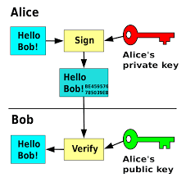

Slide 40
Authentication of Electronic Records
(1) Subject to the provisions of this section any subscriber may authenticate an electronic record by affixing his Digital Signature.
(2) The authentication of the electronic record shall be effected by the use of asymmetric crypto system and hash function which envelop and transform the initial electronic record into another electronic record.

Slide 41
For the purposes of this sub-section, "Hash function" means an algorithm mapping or translation of one sequence of bits into another, generally smaller, set known as "Hash Result" such that an electronic record yields the same hash result every time the algorithm is executed with the same electronic record as its input making it computationally infeasible
(a) to derive or reconstruct the original electronic record from the hash result produced by the algorithm;
(b) that two electronic records can produce the same hash result using the algorithm.

Slide 42
(3) Any person by the use of a public key of the subscriber can verify the electronic record.
(4) The private key and the public key are unique to the subscriber and constitute a functioning key pair.

Slide 43
3A Electronic Signature (Inserted vide ITAA 2006)
Notwithstanding anything contained in section 3, but subject to the provisions of sub-section (2a) subscriber may authenticate any electronic record by such electronic signature or electronic authentication technique which-
(a) is considered reliable ; and
(b) may be specified in the Second Schedule
(2) For the purposes of this section any electronic signature or electronic authentication technique shall be considered reliable if-
(a) the signature creation data or the authentication data are, within the context in which they are used, linked to the signatory or , as the case may be, the authenticator and of no other person;

Slide 44
(b) the signature creation data or the authentication data were, at the time of signing, under the control of the signatory or, as the case may be the authenticator and of no other person;
(c) any alteration to the electronic signature made after affixing such signature is detectable
(d) any alteration to the information made after its authentication by electronic signature is detectable; and
(e) it fulfills such other conditions which may be prescribed.

Slide 45
(3) The Central Government may prescribe the procedure for the purpose of ascertaining whether electronic signature is that of the person by whom it is purported to have been affixed or authenticated
(4) The Central Government may, by notification in the Official Gazette, add to or omit any electronic signature or electronic authentication technique and the procedure for affixing such signature from the second schedule; Provided that no electronic signature or authentication technique shall be specified in the Second Schedule unless such signature or technique is reliable.
(5) Every notification issued under sub-section (4) shall be laid before each House of Parliament.

Slide 46
Legal architecture for validity of digital signature
-transactions over internet need to address issues related to authentication, integrity and nonrepudiation.
- can be dealt with use of digital signature.
- PKI enable use of digital signature.
Certification Authorities
-section 17(ITA,2000)-CCA appointed by central government to license and regulate working of certifying Authorities(CAs).
- CAs issue digital signature certificates for electronic authentication of users.

Slide 47
- CCAs established the Root Certifying Authority (RCAI) of India under section 18(b) of ITA,2000, to digitally sign public keys of CAs in India.
- Section 18(ITA,2000), digital signatures based on asymmetric cryptosystems, are accepted as per with handwritten signatures.

Slide 48
Licensing of certifying Authorities
Section 87(ITA 2000) defines rules and guidelines for CAs
Creation and verification of digital signatures
IT architecture that CAs may support
Information that digital signature certificates must contain
Eligibility for licensing of CAs.
Form, information and fees to be submitted with an application for license to become CA.
Requirement for cross certification with other licensed CAs.
Validity, renewal and suspension of license granted to a CA.

Slide 49
8. Conditions under which the controller may refuse to grant a license or refuse to renew a license.
9. Security guidelines for CAs.
10. Requirements prior to ceasing activities as a CA.
11. Database of disclosure records of CAs to be maintained by controller.
12. generation and issues regarding digital certificates
13. Fees that CAs can charge.

Slide 50
Relevant sections:
Sec 8, ITA 2000- licensing of certifying authorities- provides the requirements to apply for grant of a licence to issue DSC to an individual or a company.
Sec 35, ITA, 2000-CA to issue DSC- the requirements and the procedure for obtaining the digital signature from CA.

Slide 51
Digital signature
Digital Signatures are legally admissible in a Court of Law, as provided under the provisions of IT Act, 2000 (sec 18).
Digital Signature Certificates (DSC) are the digital equivalent (that is electronic format) of physical or paper certificates. Few Examples of physical certificates are drivers' licenses, passports or membership cards. Certificates serve as proof of identity of an individual for a certain purpose; for example, a driver's license identifies someone who can legally drive in a particular country. Likewise, a digital certificate can be presented electronically to prove one’s identity, to access information or services on the Internet or to sign certain documents digitally.

Slide 52
Process to get DSC:
Digital Signature Certificate (DSC) Applicants can directly approach Certifying Authorities (CAs) with original supporting documents, and self-attested copies will be sufficient in this case • DSCs can also be obtained, wherever offered by CA, using Aadhar eKYC based authentication, and supporting documents are not required in this case
A letter/certificate issued by a Bank containing the DSC applicant’s information as retained in the Bank database can be accepted. Such letter/certificate should be certified by the Bank Manager .

Slide 53
Who issues DSC
A licensed Certifying Authority (CA) issues the digital signature. Certifying Authority (CA) means a person who has been granted a license to issue a digital signature certificate under Section 24 of the Indian IT-Act 2000.
Under sec 17 of ITA 2000, controller of certifying authorities (CCA) has been appointed by central government to licence and regulate working of CAs.

Slide 54
Intellectual property Aspect in Cyber law
Intellectual property (IP) refers to intangible property that is a creation of the human mind, such as inventions, literary and artistic works, designs, and symbols, names and images used in commerce.
As it is intangible, protecting it is very difficult.
Intellectual property can be protected by copyright, trademark, patent or other legal measure.
IP rights provide the innovators and creators legal protection for their ideas and creations.

Slide 55
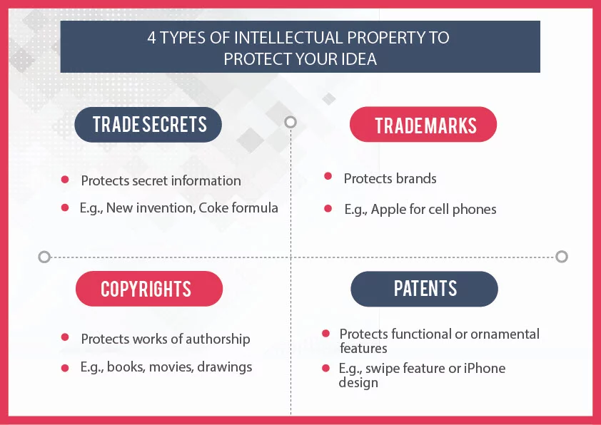

Slide 56
1. Patents:Patent is an exclusive right granted by a government for an invention that is new, involves inventive step and is capable of industrial application. Section 2(1)(m) of the Indian Patent Act, 1970 defines patent as: "patent" means a patent for any invention granted under this Act.
The three most common types are utility patents, design patents, and plant patents.
Patent act amended in 2005 and patent rules in 2006. Term of every patent is 20 years from date of application.
Toyota Jidosha Vs M/S Prius Auto Industries Ltd.

Slide 57
Patent act 1970
Amended in 2002
Section 4(k) of 2002 act-computer program is not patentable (if it is a part of invention then only it is patentable.)

Slide 58
Trade Secrets
-A trade secret may refer to a practice, process, design, instrument or a compilation of data or information relating to the business which is not generally known to the public and which the owner reasonably attempts to keep secret and confidential.
- Such data or information may also involve an economic interest of the owner in obtaining an economic advantage over competitors.
- no specific law. Sec 72, ITA 2000 provides protection to electronic records. Usually companies use non disclosure agreement to protect confidentiality of secrets of company.

Slide 59
Trade Secrets are capable of being considered within the framework of contract, competition and intellectual property laws simultaneously.
They can be protected by way of restrictive covenants, non-disclosure agreements and other contractual means.
Additionally, Trade Secrets can also be protected by an action against misappropriation under common law, wherein misappropriation of trade secrets may occur by way of breach of an obligation of confidence, whether arising impliedly or expressly, as well as theft.
Mr. Anil Gupta vs Mr. Kunal Dasgupta(97(2002)DLT 257

Slide 60
Trademarks
- Trademark defined under Section 2 (zb) of the Trade Marks Act, 1999 as, "trade mark means a mark capable of being represented graphically and which is capable of distinguishing the goods or services of one person from those of others and may include shape of goods, their packaging and combination of colours”.
- The symbol R means that the trademark is now registered. As soon as you apply for a Trademark you can use the TM symbol. The R symbol can be used only upon registration. It can take a couple of years in India to get your trademark registered (after applying for it).
Munish kumar Singla Trading as Chakshu food poducts Vs Jollibee Foods corp.

Slide 61
Geographical Indication
- A geographical indication (GI) is a name or sign used on certain products which corresponds to a specific geographical location or origin (e.g. a town, region, or country), indicating the source of the product.
- (i) the basic protection applicable to all GI in general (under Article 22), and (ii) additional protection applicable only to the GI denominating wines and spirits (under Article 23).
- The legislations which deals with protection of GI’s in India are ‘The Geographical Indications of Goods (Registration & Protection) Act, 1999’ (GI Act), and the ‘Geographical Indications of Goods (Registration and Protection) Rules, 2002 (GI Rules).

Slide 62
Industrial Designs:
- Industrial design is a process of design applied to products that are to be manufactured through techniques of mass production. Its key characteristic is that design is separated from manufacture: the creative act of determining and defining a product's form and features takes place in advance of the physical act of making a product, which consists purely of repeated, often automated, replication.
- The registration and protection of industrial designs in India are administered by Design act, 2000, and corresponding design rules, 2001 with subsequent amendments.

Slide 63
Copyright:
-Copyright is a law that gives the owner of a work (like a book, movie, picture, song or website) the right to say how other people can use it. Copyright laws make it easier for authors to make money by selling their works. ... If someone copies a work without permission, the owner can say they infringed their copyright.
Copyright law grants authors and artists the exclusive right to make and sell copies of their works, the right to create derivative works, and the right to perform or display their works publicly.

Slide 64
In India, the existing intellectual property regime that deals with the protection of computer software is the Indian Copyright Act, 1957. At present, legal system and framework are inadequate to address all the aspects of Information Technology (IT).
1984 Act: discouraging
and preventing widespread video piracy.
which provides for hefty fines and heftier sentences for anybody trading in or publicly exhibiting, illegally recorded video cassettes.

Slide 65
Under section 13 of the Copyright Act 1957, copyright protection is conferred on literary works, dramatic works, musical works, artistic works, cinematograph films and sound recording. ... Copyright refers to a bundle of exclusive rights vested in the owner of copyright by virtue of Section 14 of the Act.
RG Anand Vs Delux films (AIR 1978 SC 1613)
Amended in 2012- defines terms computer(2ffb) and computer program (2ffc) in section 2.
Act 1957- protects databases – section 13(1)
63(b)-knowing use of infringing copy of computer prog to be an offence.

Slide 66
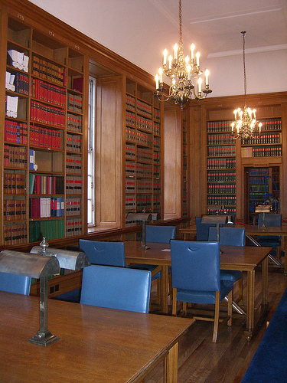


What Copyright Protects
Original Literary, Dramatic, Musical and Artistic Works
Cinematograph Films
Sound Recordings
Notes:
‹#›

Slide 67

Literary Works
Novels, poems, short stories
Books on any subject
Computer programmes,
tables, computer
databases
Song lyrics
Notes:
‹#›

Slide 68
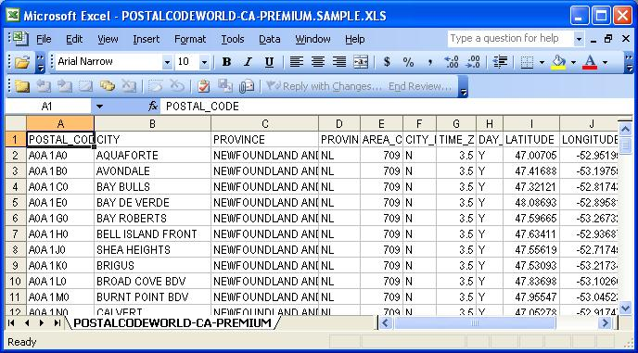
Computer Software
Includes
Programme Manuals
Punched Cards
Magnetic Tapes/Discs
Computer printouts
Computer programmes
Notes:
‹#›

Slide 69
Evidence Aspect in Cyber law
Evidence is anything that you see, experience, read, or are told that causes you to believe that something is true or has really happened. ... Evidence is the information which is used in a court of law to try to prove something. Evidence is obtained from documents, objects, or witnesses.

Slide 70
There are four general types of evidence:
1 Real evidence (tangible things, such as a weapon)
2 Demonstrative (a model of what likely happened at a given time and place) – pictures, x-rays, diagrams, maps, drawings, graphs, animations, simulations, models, etc.
3 Documentary (a letter, blog post, or other document) – invoice, contract, will, etc.
4 Testimonial (witness testimony)- oral or written statements, affidavit

Slide 71
Indian Evidence Act, 1872
This Act is divided into three parts and there are 11 chapters in total under this Act.
Part 1-Part 1 deals with relevancy of the facts. There are two chapters under this part: the first chapter is a preliminary chapter which introduces to the Evidence Act and the second chapter specifically deals with the relevancy of the facts.
Part 2-Part 2 consists of chapters from 3 to 6. Chapter 3 deals with facts which need not be proved, chapter 4 deals with oral evidence, chapter 5 deals with documentary evidence and chapter 6 deals with circumstances when documentary evidence has been given preference over the oral evidence.

Slide 72
Part 3:The last part, that is part 3, consists of chapter 7 to chapter 11. Chapter 7 talks about the burden of proof. Chapter 8 talks about estoppel ( prevents someone from arguing something contrary to a claim made or act performed by that person previously), chapter 9 talks about witnesses, chapter 10 talks about examination of witnesses, and last chapter which is chapter 11 talks about improper admission and rejection of evidence

Slide 73
Amendments to evidence act, 1872
ITA 2000-amended IEA 1872
Act 21 of ITA 2000,sec 92- include electronic records
Sec 3- definition of evidence is amended
Sec 17- definition of admission changed from “oral or documentary” to oral or documentary or “contained in electronic form”.
Sec 22A added to provide for the relevancy of oral evidence regarding the contents of electronic record.
Sec 65 A-65B
Sec 67A

Slide 74
Criminal Aspects in cyber law
A crime is an unlawful act that is forbidden and punishable by the law.
It is an act that could be harmful to an individual, a community, society or the state.
The same is true even if it is done using technology, called as cyber crime.
To combat against cybercrime, India enacted the ITA, 2000, which amended various existing laws related to crime in India.

Slide 75
Indian Penal code (IPC), 1860
It contains 23 chapters with 511 sections.
ITA 2000 has made several amendments to the Indian Penal Code. Due to this, cyber crime cases in India are also registered under the IPC. Different sections of IPC pertaining to cyber crime are listed below.

Slide 76
Ranbir Penal Code (RPC), a criminal code specific to Jammu and Kashmir, which has its own constitution and laws granted under Article 370 of the Indian Constitution.
Indian Penal Code, Criminal Law among 37 Central Laws to be applicable in Jammu and Kashmir
The cabinet had approved the order for adaptation of Central Acts in the Union Territory under Section 96 of the Jammu and Kashmir Reorganisation Act, 2019
Jammu and Kashmir Reorganisation Act, 2019 came into force on October 31, 2019

Slide 77
Sec 29A: electronic record
-Important amendment of IPC by ITA is substitution of the word “document” for the words “document or electronic record”.
- Electronic record means data, record or data generated, image or sound stored, received or sent in an electronic form or microfilm or computer generated microfiche.(sec 2(1)(t) of ITA, 2000).

Slide 78
Sec 463: forgery
-According to Section 463 of the Indian Penal Code, “Whoever makes any false documents or false electronic record or part of a document or electronic record, with intent to cause damage or injury, to the public or to any person, or to support any claim or title, or to cause any person to part with property, or to enter into any express or implied contract, or with intent to commit fraud or that fraud may be committed, commits forgery.

Slide 79
Sec 464: making a false document
- dishonestly or fraudulently
makes, signs, seals or executes a document or part of a document.
Makes or transmits any electronic record or part of record
Affix electronic signature with the intention of causing it to be believed authentic.
- Alters doc or electronic record.
Phishing, spoofing using fake websites and e-mails are also addressed by this section of IPC.

Slide 80
Sec 499: defamation
Law of defamation is also extended to speech and documents along with publishing defamatory material using internet in ITA, 2000.
The offence of defamation is punishable under section 500 of IPC with imprisonment upto 2 years or fine or both.

Slide 81
IPC Section | Description
292
292A
293
294
420
463
464
468
469
499
503
Summary of IPC sections applicable to cybercrimes

Slide 82
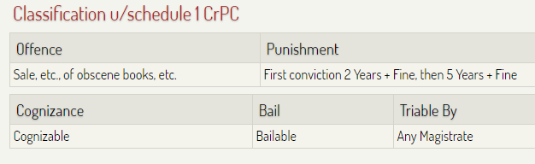
Section 292 IPC
a book, pamphlet, paper, writing, drawing, painting, representation, figure or any other object, shall be deemed to be obscene if it is lascivious or appeals to the prurient interest or if its effect (is) such as to tend to deprave and corrupt person.

Slide 83
cognizable offence means an offence in which a police officer has the authority to make an arrest without a warrant and to start an investigation with or without the permission of a court.

Slide 84
Electronic data interchange (EDI)
What is EDI?
Exchange of electronic data between companies using precisely defined transactions.
Set of hardware, software, and standards that accommodate the EDI process.
Common examples include purchase orders (EDI 850), shipping status (EDI 214), invoices customs information, payment confirmations (EDI 820), and inventory documents.

Slide 85
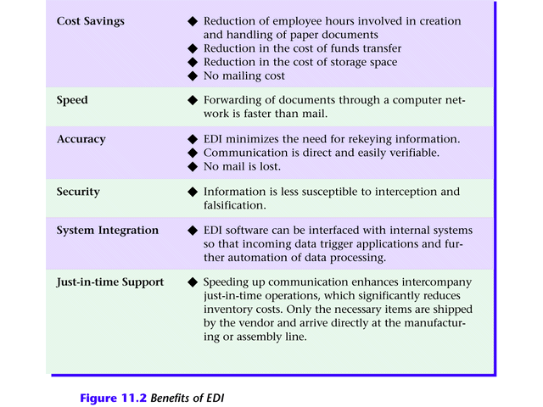
Benefits of EDI

Slide 86
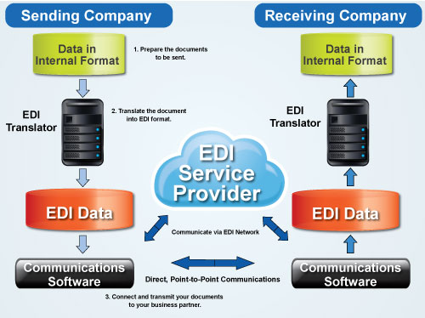
EDI communication

Slide 87
How does EDI work?
Supplier’s proposal sent electronically to purchasing organization.
Electronic contract approved over network.
Supplier manufactures and packages goods, attaching shipping data recorded on a bar code.
Quantities shipped and prices entered in system and flowed to invoicing program; invoices transmitted to purchasing organization

Slide 88
Manufacturer ships order.
Shipment notice EDI transaction sent.
Purchasing organization receives packages, scans bar code, and compares data to invoices actual items received.
Payment approval transferred electronically.
Bank transfers funds from purchaser to supplier’s account using electronic fund transfer (EFT).

Slide 89
Standard format–
Because EDI documents must be processed by computers rather than humans, a standard format must be used so that the computer will be able to read and understand the documents.
A standard format describes what each piece of information is and in what format (e.g., integer, decimal, mmddyy).
Without a standard format, each company would send documents using its company-specific format and, much as an English-speaking person probably doesn’t understand Japanese, the receiver’s computer system doesn’t understand the company-specific format of the sender’s format.

Slide 90
There are several EDI standards in use today, including ANSI, EDIFACT, TRADACOMS and ebXML. And, for each standard there are many different versions, e.g., ANSI 5010 or EDIFACT version D12, Release A.
When two businesses decide to exchange EDI documents, they must agree on the specific EDI standard and version.
Businesses typically use an EDI translator – either as in-house software or via an EDI service provider – to translate the EDI format so the data can be used by their internal applications and thus enable straight through processing of documents.
An EDI document is comprised of data elements, segments and envelopes that are formatted according to the rules of a particular EDI standard.

Slide 91
EDI communication Methods
1. Direct EDI/ point to point
Brought to prominence by Walmart, direct EDI, sometimes called point-to-point EDI, establishes a single connection between two business partners. In this approach, you connect with each business partner individually. It offers control for the business partners and is most commonly used between larger customers and suppliers with a lot of daily transactions.

Slide 92
2. EDI via VAN
Value Added Networks (VANs) are private networks where electronic business documents are exchanged between partners. The VAN provider manages the network and provides companies with mailboxes where they can send and receive EDI documents.
3. EDI via AS2
AS2 is an Internet communications protocol that enables data to be transmitted securely over the Internet.

Slide 93
4. EDI via Web
Unlike EDI via AS2, Web EDI conducts EDI using a standard Internet browser. Organizations use different online forms to exchange information with business partners. Web EDI makes EDI easy and affordable for small- and medium-sized organizations and companies that have only occasional need to utilize such a service.

Slide 94
5. Mobile EDI
Users have commonly accessed EDI either by a private network such as Value Added Network or the Internet in order to send and receive EDI-related business documents.
Mobile EDI has had limited adoption, in part due to security concerns with mobile devices across an EDI infrastructure, but mainly due to the mobile devices themselves.

Slide 95
6. EDI outsourcing
EDI Outsourcing (also referred to as Managed Services) is a fast-growing option that enables companies to use external resources to manage their EDI environment on a day-to-day basis.
This is in part driven by companies wanting to integrate to back office business systems such as Enterprise Resource Planning (ERP) platforms. Many companies do not have the internal resources to undertake this type of work so they outsource it instead.

Slide 96
Legal Framework for EDI
UNCITRAL(United nations commission on International Trade Law) proposed the model law on EDI in 1996
Art 2 of model law defines EDI as “ electronic transfer from computer to computer of information using an agreed standard to structure the information”.
The model law :
Establish rules and norms that validate and recognize contracts formed through electronic means.
Sets the rules for forming contracts and governing electronic contract performance.

Slide 97
3. Defines the characteristics of valid electronic writing and of an original document.
4. Provides for the acceptability of electronic signatures for legal and commercial purposes.
5. Supports the admission of computer evidence in courts and arbitration proceedings.
In India IT Act, 2000 provides legal recognition for transactions carried out by means of EDI and other means of electronic communication.

Slide 98
Electronic Banking in India:
The way of performing banking operations has changed tremendously with technology development.
Different types of services offered by bank to customers.
Easy payment systems such as RTGS, NEFT, IMPS,ATM card, debit card, Credit card.

Slide 99
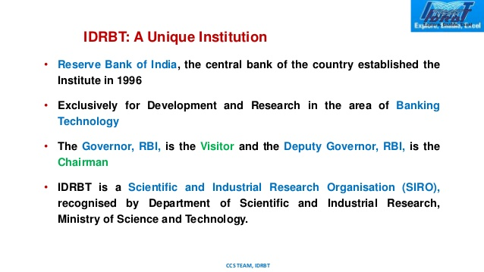

Slide 100
IDRBT is also a licensed CA for providing DSC to individuals and organisations.
IDRBT owns
Indian Financial Network (INFINET)
-backbone for Indian banking and financial sectors.
-Various intra-bank and interbank applications are being implemented by INFINET. These applications use a strong PKI based security.
NEFT is also maintained by RBI. It was developed and maintained by IDRBT and was started in 2005.

Slide 101
NPCI: National Payments Corporation (NPCI)
Established in 2008 and commenced operations in 2009 with an objective towards less cash society.
It is an umbrella organisation for operating retail payments and settlement systems in India.
The Corporation has actively promoted several retail payment platforms like the BHIM, UPI, Aadhar Based Payment Systems etc. The IMPS and National Financial Switch are the other notable contributions of NPCI.
Introduced many innovative service such as RuPay, UPI, IMPS, Aadhaar enabled payment system, National Financial Switch (NFS).

Slide 102
Indian Laws Related to Electronic Banking
Bankers Books Evidence Act, 1891
Applied to legal cases involving transactions where the banking records can be cited as evidence.
Contains 8 sections including definition, scope and objective of the Act.
Applicable to all institutes or companies which carries out banking operations.
ITA 2000 made amendment to this act in sec 2: “definitions” and have added section 2A: “conditions in the printout”

Slide 103
Sub section 2(3)(a): “bankers’ books” include ledgers, day-books, account books and all other books used in ordinary business of a bank whether kept in the written form or as printouts of data stored in floppy, disc, tape or any other form of electromagnetic data storage device.
Sub section 2(8): “certified copy” means when the book of a bank, consists of printout of data stored in a floppy, disc, tape or any other electromagnetic data storage device, a printout of such entry or a copy of such printout together with such statements certified in accordance with the provisions of sec 2A (conditions in the printout).

Slide 104
Section 2A: Conditions in the printout:
Three certificates along with printout need to be provided
Branch manager/Principal accountant (authenticate)
In charge of computer system (security measures to ensure integrity of data)
In charge of computer system (machine was in working condition)

Slide 105
2. Reserve Bank of India Act, 1934
-Provides framework for supervision of banks and other related matters in India.
-It empowers RBI to act as the banker to the government and manage the public debt.
As per sec 22, only RBI can issue and regulate currency notes in India.
Amended by ITA 2000.
Added clause (p) in sec 58 sub sec (2): facilitate electronic fund transfer and ensure legal admissibility of documents and records related to such transaction.

Slide 106
- Deals with regulation of fund transfer through 15 electronics means between banks including RTGS, NEFT, IMPS,etc.

Slide 107
3. Payment and Settlement System Act, 2007
To govern and regulate all the modes of payment systems used in India.
Gives power to RBI to direct and regulate the payment systems and the payment system participants in India.
Payment systems includes the systems to enable payment operations using credit cards, debit cards, smart cards, different modes of electronic fund transfer.
It does not include payment operations involving stock exchange or and clearing corporations set up under stock exchanges.

Slide 108
Sec 2(1)(i) of PSS act: “payment system” means that enables payment to be effected between a payer and beneficiary, involving clearing, payment or settlement service or all of them but does not include a stock exchange:
RBI made 2 regulations under PSS act 2007
1. Board for regulation and supervision of payment and settlement systems regulations, 2008(BPSS regulation)
2. Payment and settlement systems regulations, 2008(PSS regulations)

Slide 109
Questions:
What are some prominent Global Initiatives in the development of cyberlaw?
What is Electronic Data interchange? explain EDI communication.
Explain Electronic banking in India.
What are the laws related to electronic banking in India?
Explain the need for an Indian cyberlaw.

